Slide 1
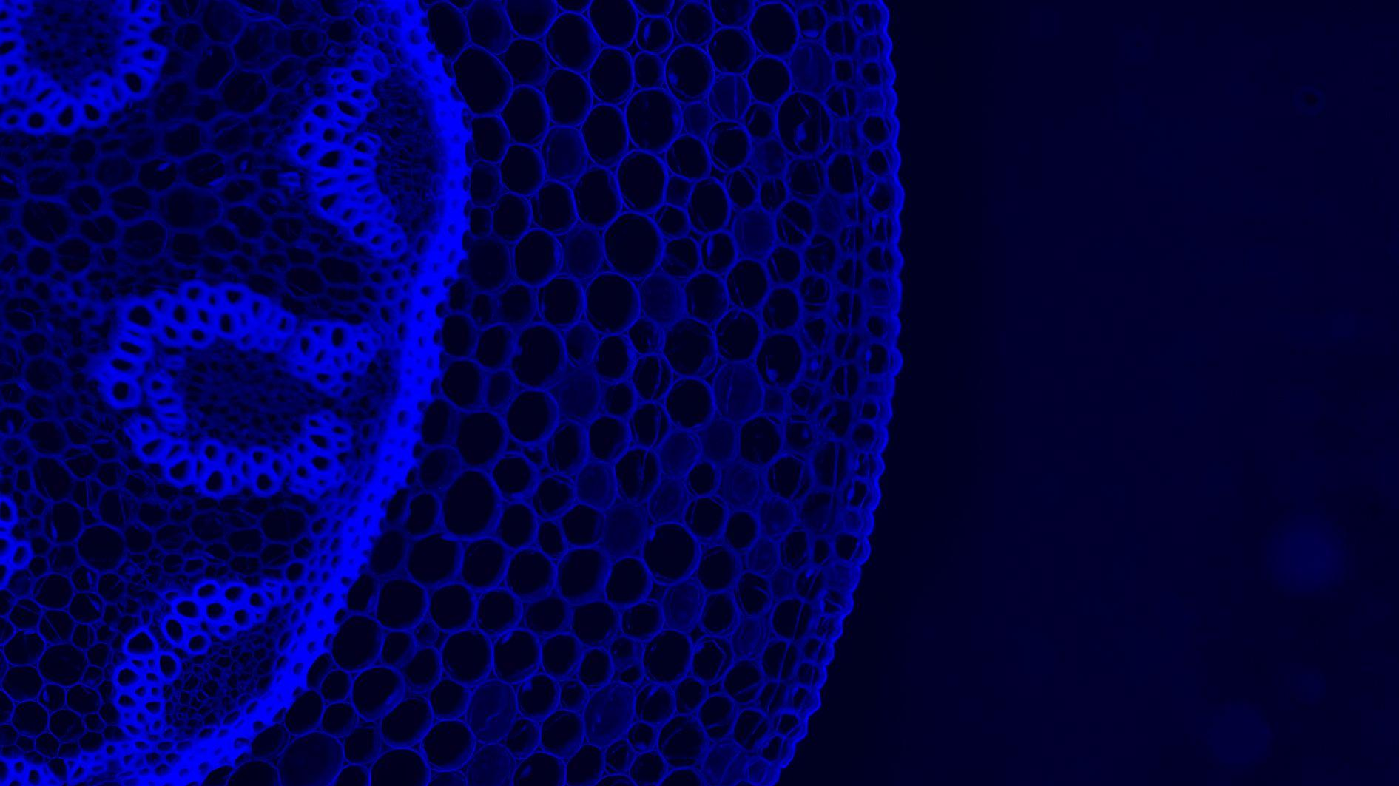
Century of Biology
© 10X GENOMICS, INC. 2022

Slide 2
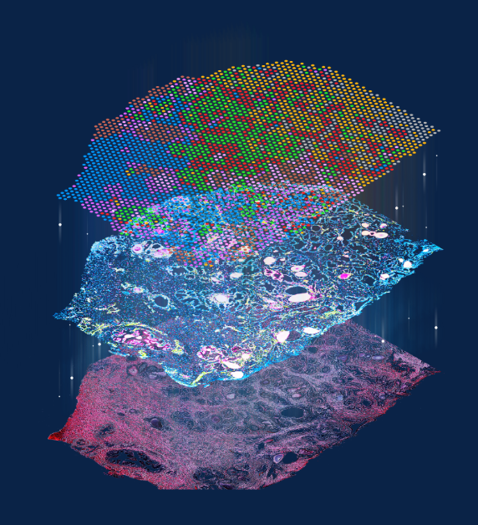
& Analityk Genetyka invite for a seminar, which will take place the 5th of October 2022, at 10:00 am in seminar room 0.31 (UW, Faculty of Biotechnology ul. Joliot-Curie 14a).
Please confirm your presence via e-mail: edyta.golinska@analitykgenetyka.pl
” Empower the full richness of biological samples with single cell and spatial transcriptomics applications”
Topics to be covered:
- single cell transcriptomics analysis
- multiomic approach for single cell analysis
- deep immune profiling on single cell level
- single cell ATAC-seq analysis
- spatial transcriptomic prolifiling of tissues
- new 10x Genomics developments
Wykładowca: Agnieszka Ciesielska PhD
Science and Technology Advisor 10x Genomics, CEE & Israel & Russia & Middle East & Africa,

